Slide 1

How to work with Git
Student: Bolatov Dias
Group: IS-1804 k

Slide 2
Steps:
Sign up
Download Desktop
3. Create repository
4. Upload files

Slide 3
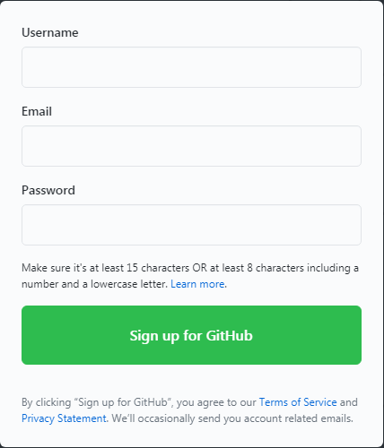
Sign in or Sign up
In order to sign up You can use this https://github.com/ link and redirect to official website of GitHub

Slide 4
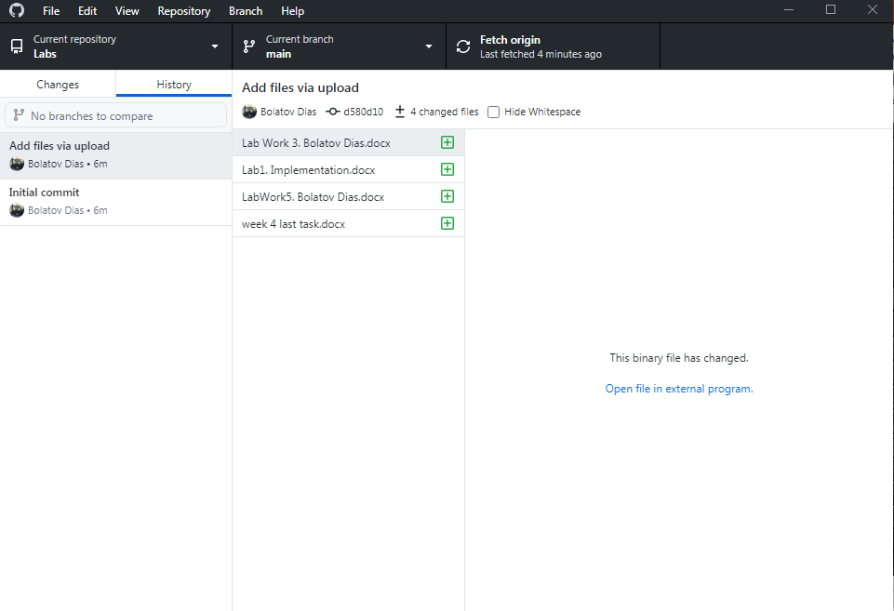
Launch Desktop

Slide 5
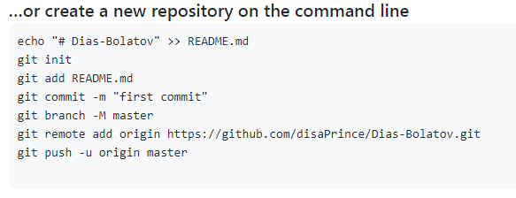
Creating using command line

Slide 6


Tools:
You can submit your changes to the project, which is also available for your teamates
Using this button you can update files(they would be updated, or assign new changes) and upload using (push)

Slide 7


